Slide 1

Exam AZ-305: Designing Azure Infrastructure Solutions Crash Course
Tim Warner

Slide 2



Tim Warner
Based in Nashville, TN, US
MCT, MVP
Twitter: @TechTrainerTim
Badge: TechTrainerTim.com

Slide 3
Day 1 of 2 Agenda
Introduction
Design identity, governance, and monitoring solutions (25-30%)
Design data storage solutions (25-30%)

Slide 4
Day 2 of 2 Agenda
Content catch-up
Design business continuity solutions (10-15%)
Design infrastructure solutions (25-30%)
Exam AZ-305 strategy

Slide 5
Course Materials
timw.info/az305

Slide 6
Level-Setting
We'll learn by doing – at least 80 percent demo
Visual, case study approach
This is an expert certification, so we move quickly and assume intermediate-level Azure skills
10-minute break at midpoint
I’m here to answer your questions – take advantage of this!
Use the Q&A panel

Slide 7
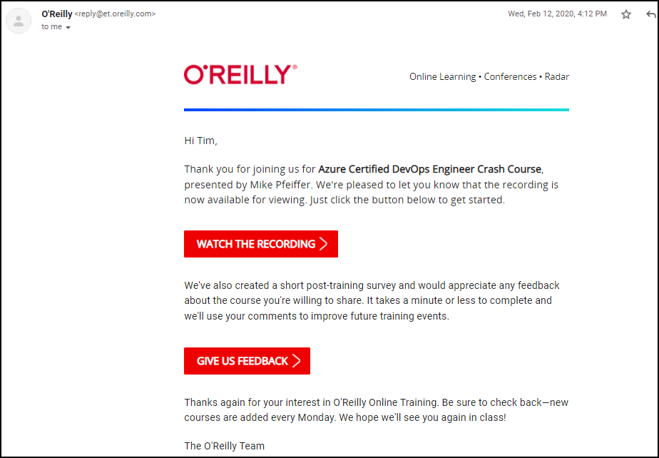
Session Recordings

Slide 8

Session Recordings

Slide 9

Session Recordings

Slide 10

Session Recordings

Slide 11


Mobile Browser: learning.oreilly.com

Slide 12



O'Reilly Mobile App

Slide 13
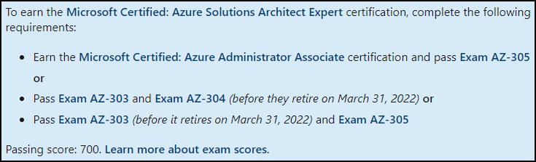
Azure Architect Cert 2022 Changes
Justification: Eliminate overlap between AZ-303 and AZ-104

Slide 14

Tim's Certification Study Model

Slide 15
Thank you!
Course materials: timw.info/az305
Twitter: @TechTrainerTim
Work: timw.info/ps
Web: TechTrainerTim.com

Slide 16
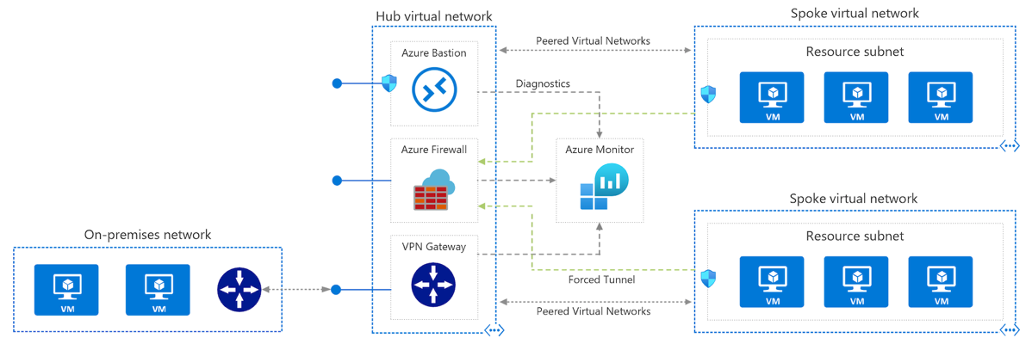
Azure VNet Hub-Spoke

Slide 17
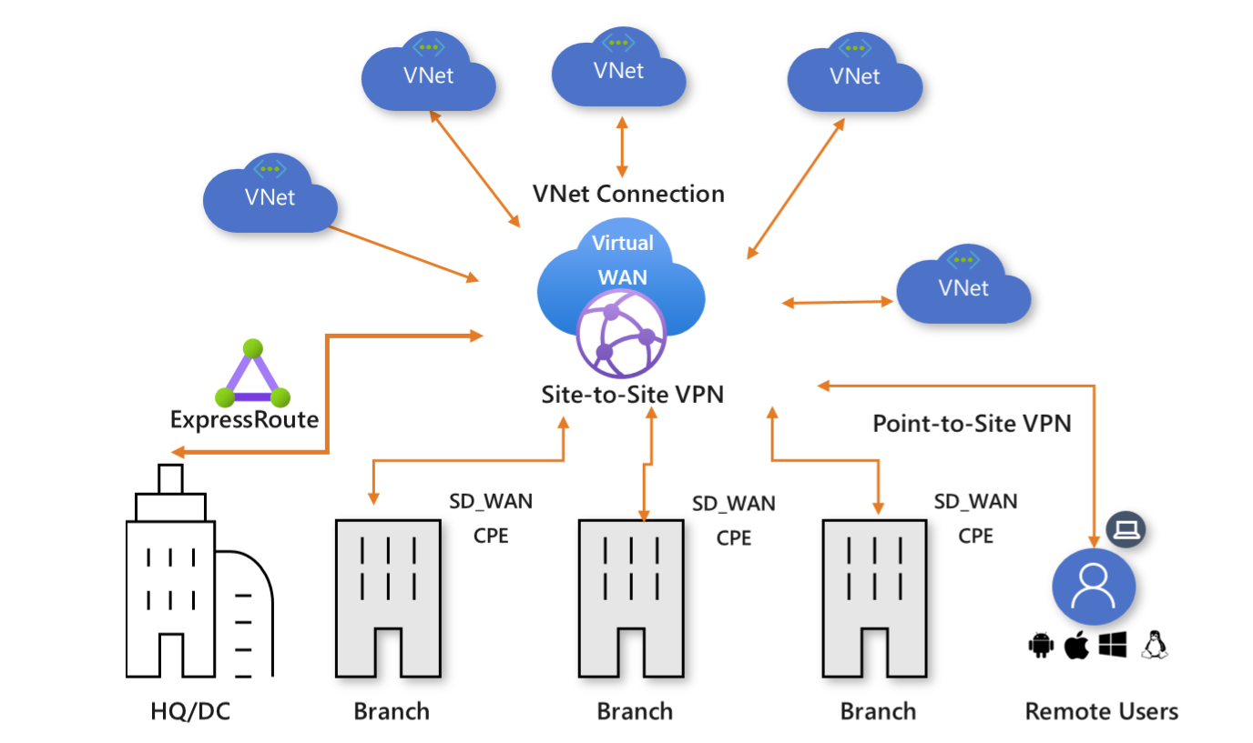
Azure Virtual WAN

Slide 18
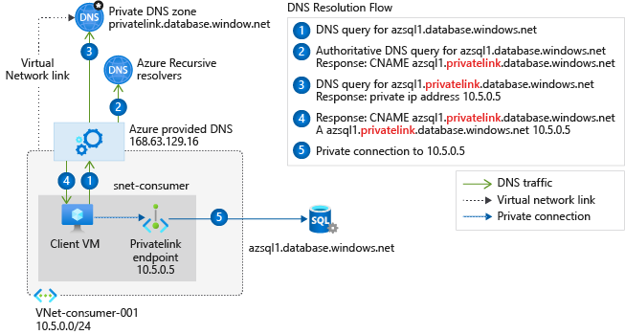
Private Link DNS Configuration

Slide 19

Azure Backup

Slide 20
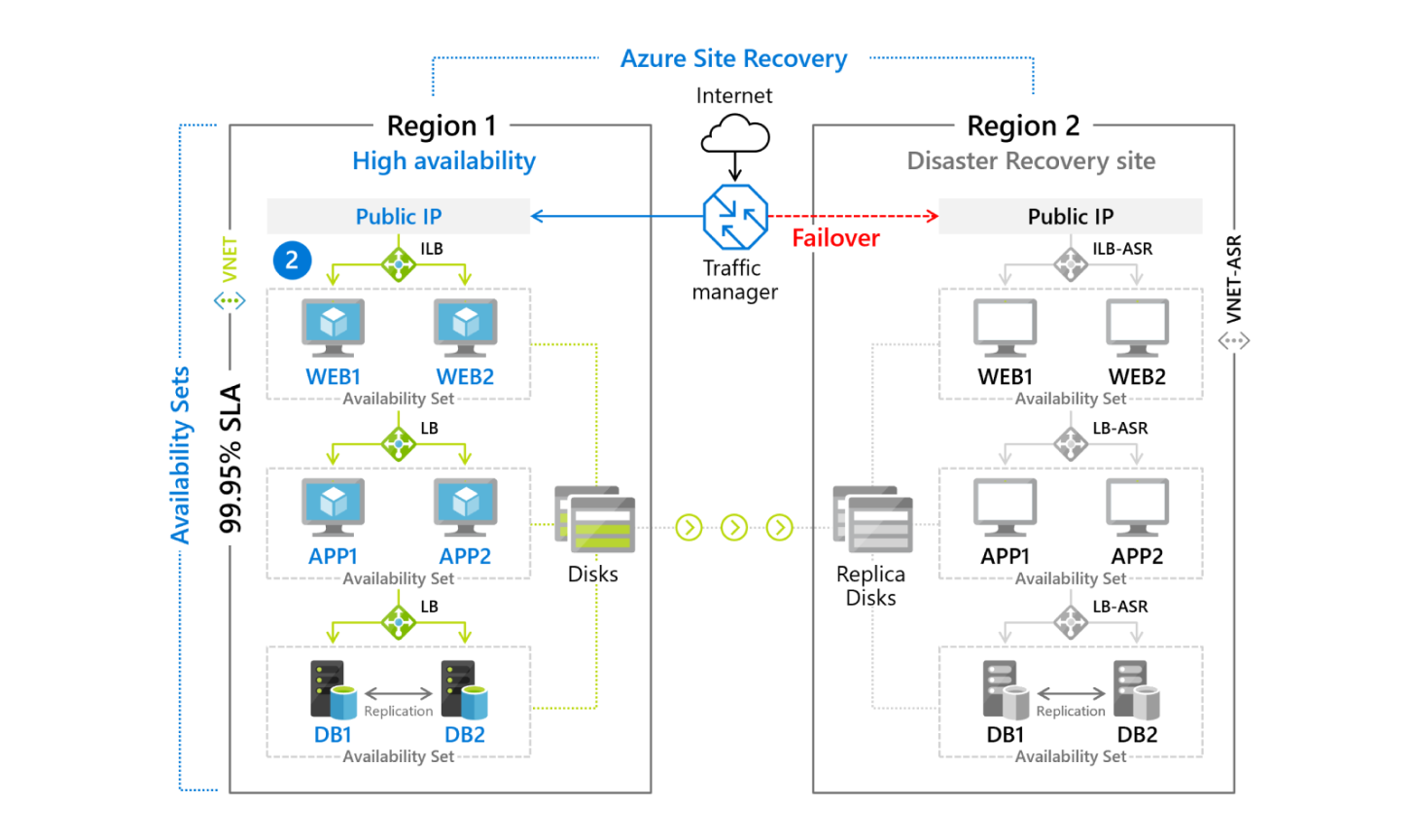
Azure Site Recovery

Slide 21

VM Scale Sets

Slide 22
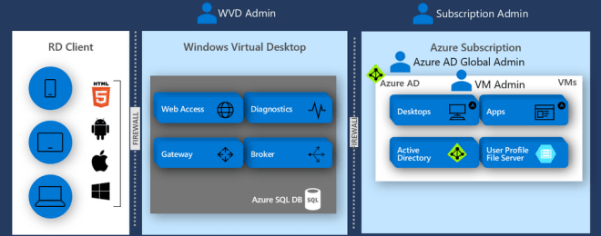
Windows Virtual Desktop (WVD)
timw.info/travis

Slide 23

Availability Set

Slide 24

Availability Zone

Slide 25

VM Networking

Slide 26

Load Balancing

Slide 27

VNet Peering

Slide 28

Hybrid Networking

Slide 29

Network Virtual Appliance

Slide 30

Azure Load Balancer

Slide 31

Application Gateway

Slide 32

Traffic Manager

Slide 33

Front Door Service

Slide 34


Docker Container Lifecycle
https://timw.info/3635f

Slide 35
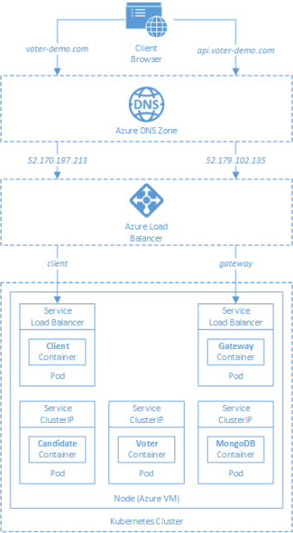
AKS

Slide 36
Azure Backup

Slide 37

Azure Site Recovery

Slide 38
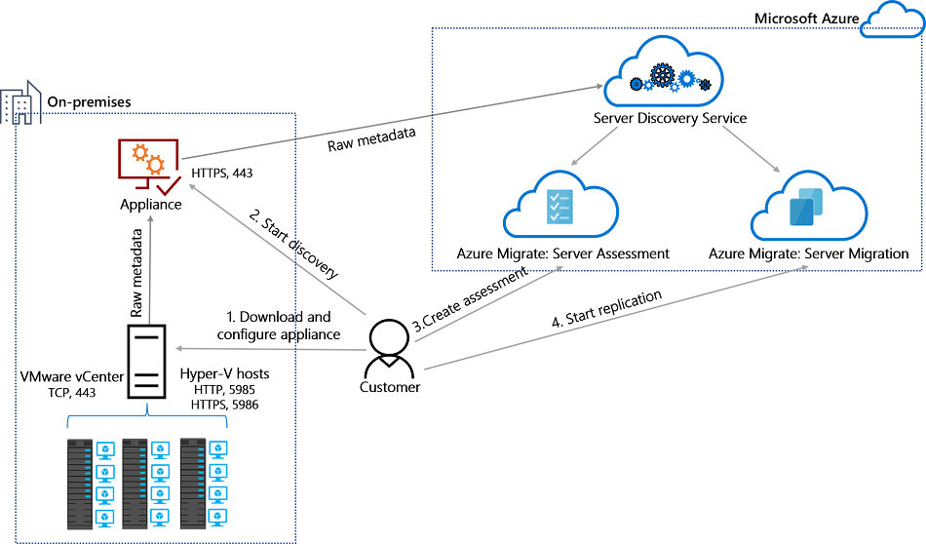
Azure Migrate

Slide 39
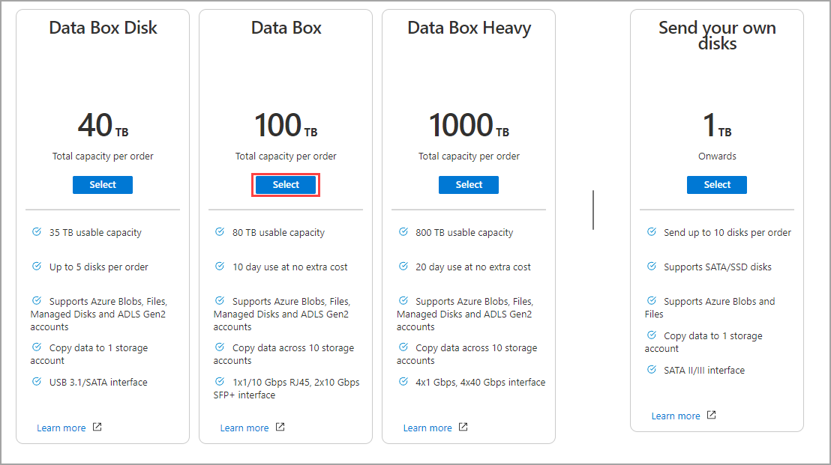
Azure Data Box

Slide 40

Azure Monitor

Slide 41

Log Analytics

Slide 42

Sentinel

Slide 43

Tenant vs. Subscription

Slide 44

Hybrid Identity

Slide 45

Azure AD B2C

Slide 46
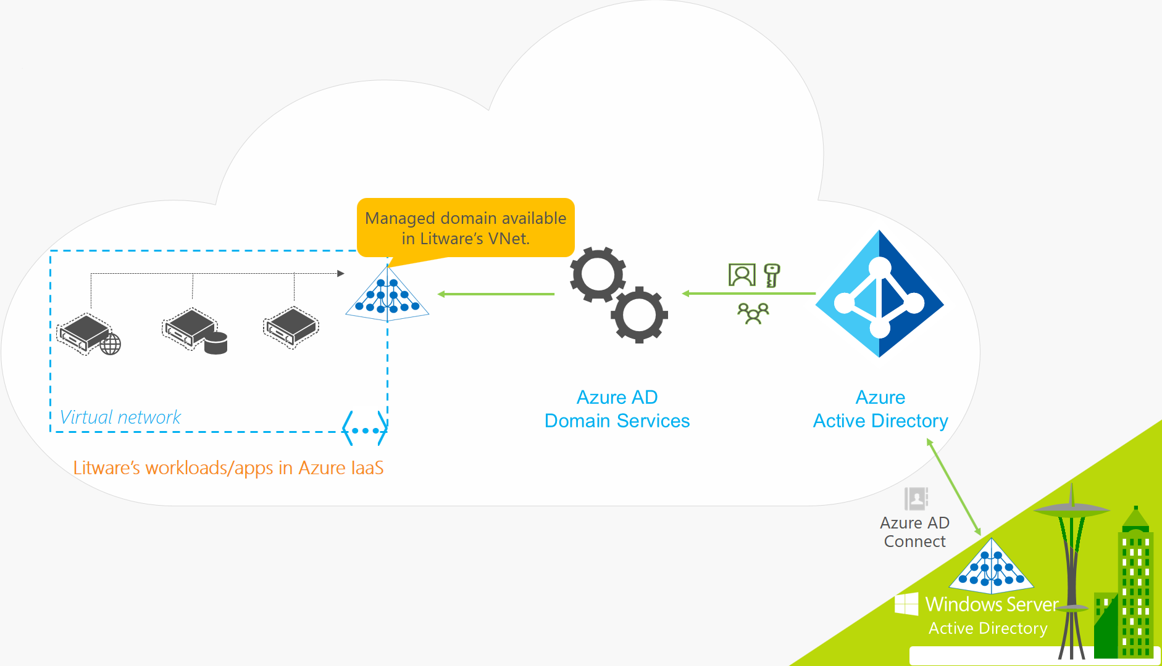
Azure AD Domain Services

Slide 47

Pass-through Authentication

Slide 48

Seamless Single Sign-on

Slide 49

Azure Management Scopes
/ Tenant Root

Slide 50

Data Pipelines

Slide 51
Storage Account Replication
1
3
3
2
LRS
ZRS

Slide 52
Storage Account Replication
3
3
GRS/RA-GRS

Slide 53
Storage Account Replication
1
3
1
3
2
2
GZRS – RA/GZRS

Slide 54

Always Encrypted

Slide 55
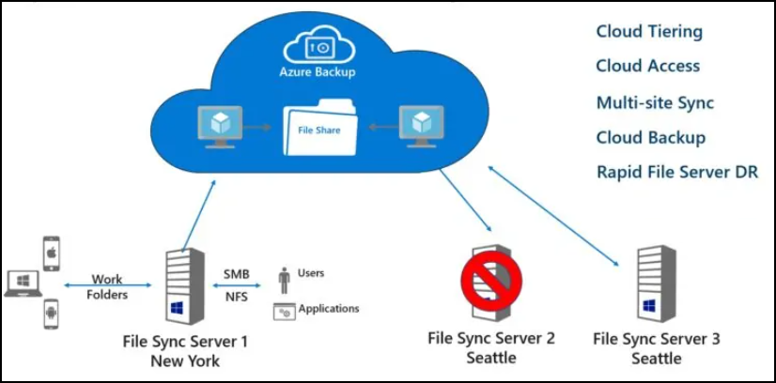
Azure File Sync

Slide 56
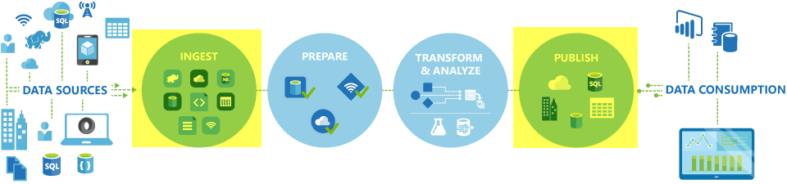
Azure Data Factory

Slide 57

Event Architecture

Slide 58

Event Architecture

Slide 59
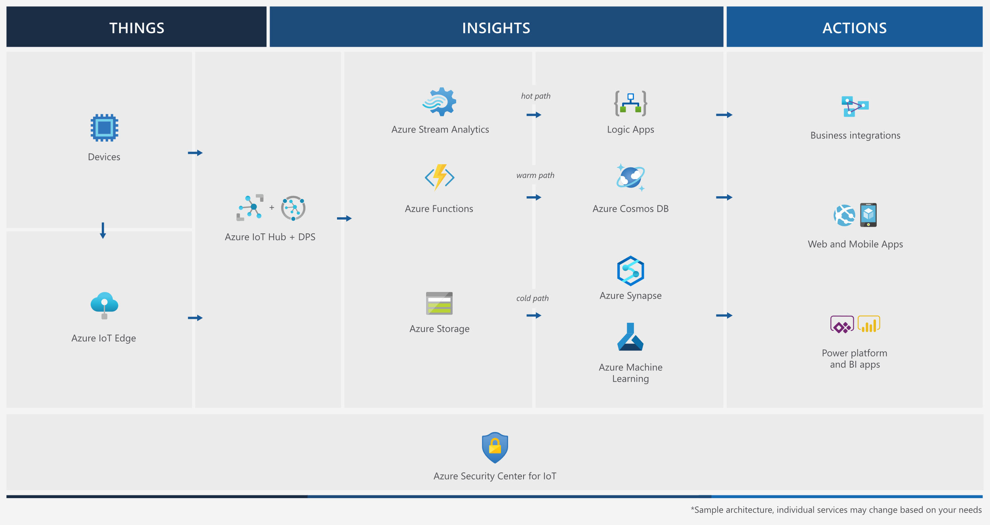
Event Architecture

Slide 60
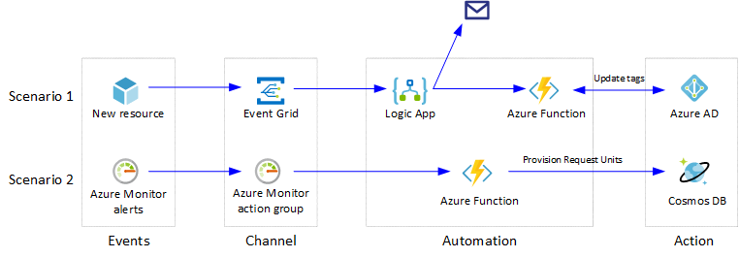
Event Architecture

Slide 61
Exam AZ-304 Item Types

Slide 62

Multiple Choice

Slide 63
Repeated Scenario
You need to move an Azure VM to another hardware host.
Solution: You redeploy the VM.
Does this solution meet the goal?
Yes
No

Slide 64

Select and Place

Slide 65

Build List and Reorder

Slide 66

Active Screen/Fill in the Blank

Slide 67

Case Study

Slide 68






Performance-Based Lab

Slide 69
Microsoft Online Testing

Slide 70
Microsoft Online Testing Process
timw.info/online

Slide 71

Microsoft Online Testing Process

Slide 72

Microsoft Online Testing Process

Slide 73

Microsoft Online Testing Process

Slide 74

Microsoft Online Testing Process

Slide 75

Microsoft Online Testing Process

Slide 76

Microsoft Online Testing Process

Slide 77

Microsoft Online Testing Process

Slide 78

Assemble the Required Materials
Webcam, microphone, and speakers
No headset
Wired or Wi-Fi Internet connection
No VPN
No tethering
Supported OS
Windows, macOS
Smartphone and ID
Mouse-based monitor
No touchscreen

Slide 79
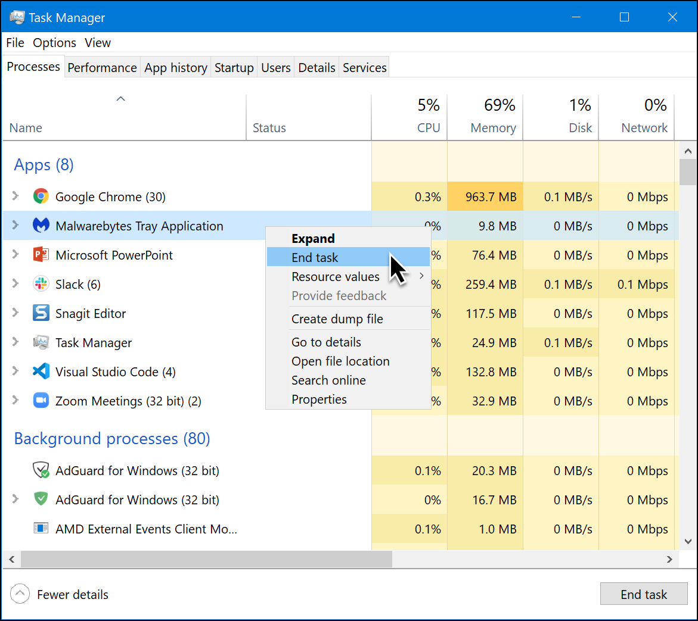
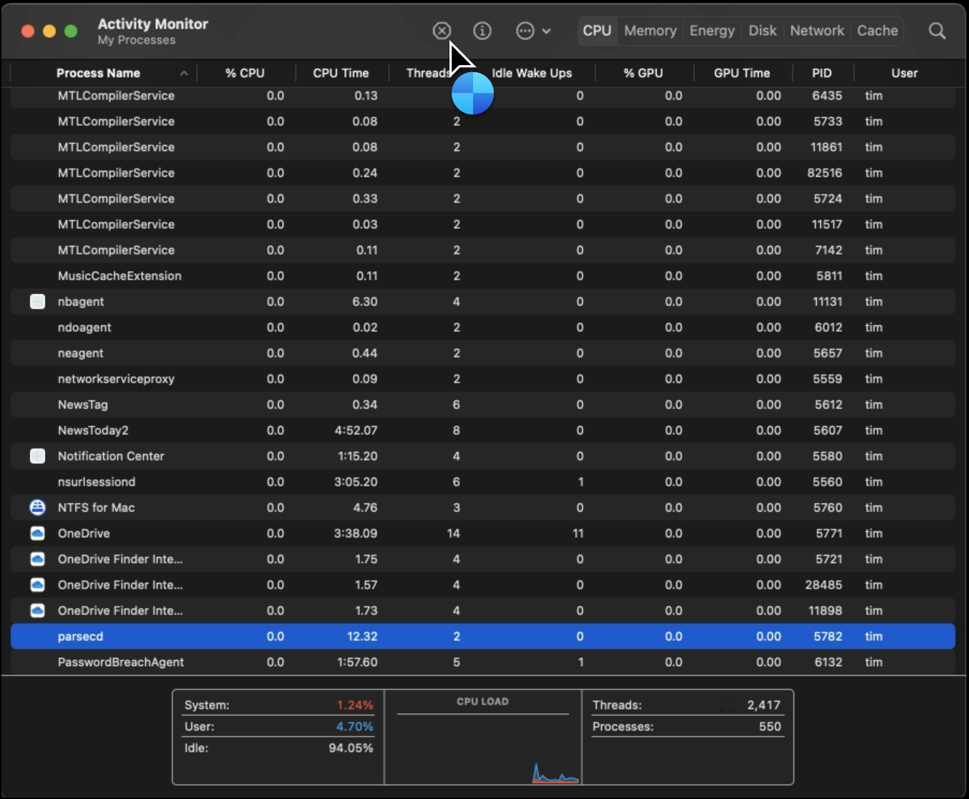
Prepare Your Testing Workstation
Windows
macOS

Slide 80
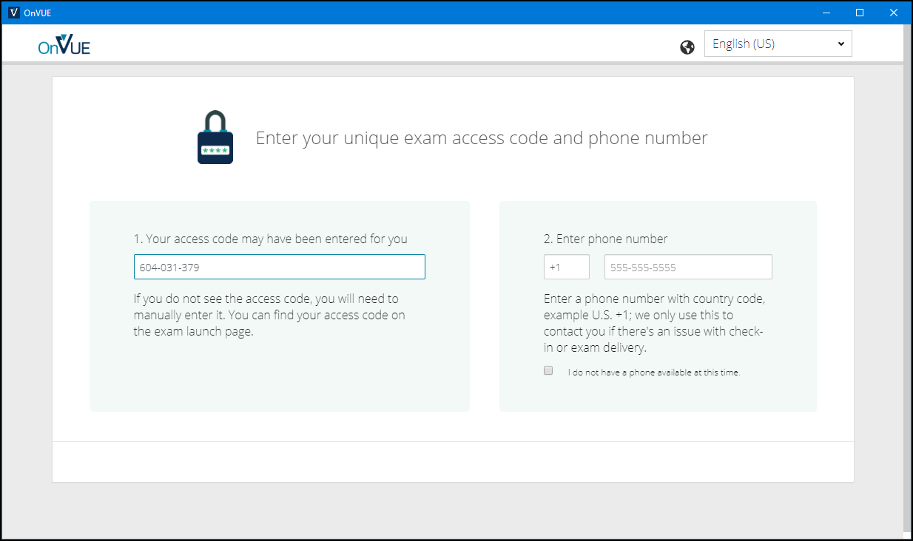
Pearson OnVUE Check-In

Slide 81
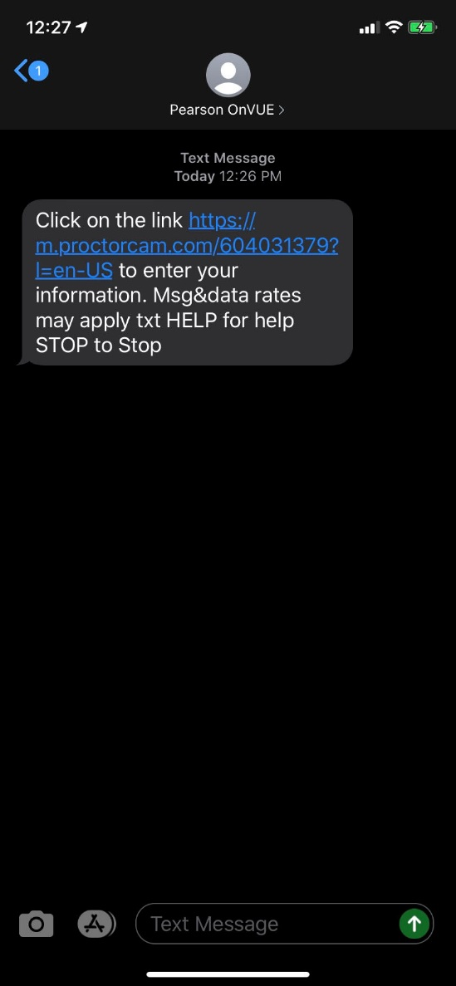
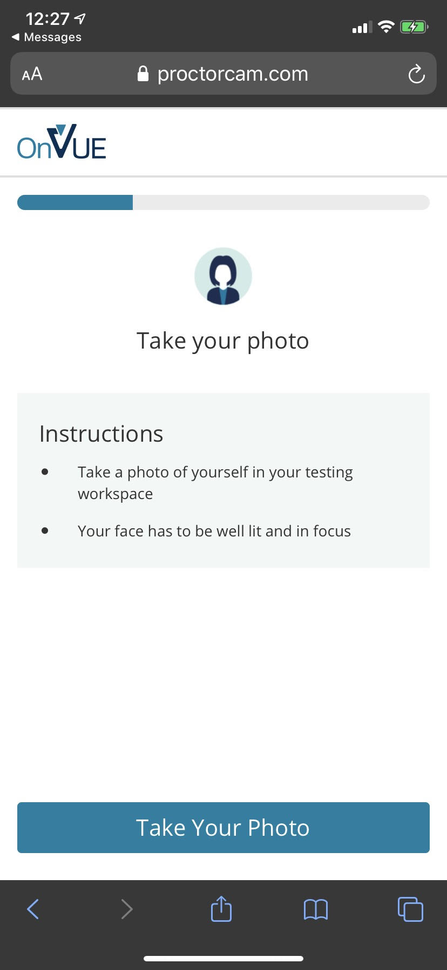
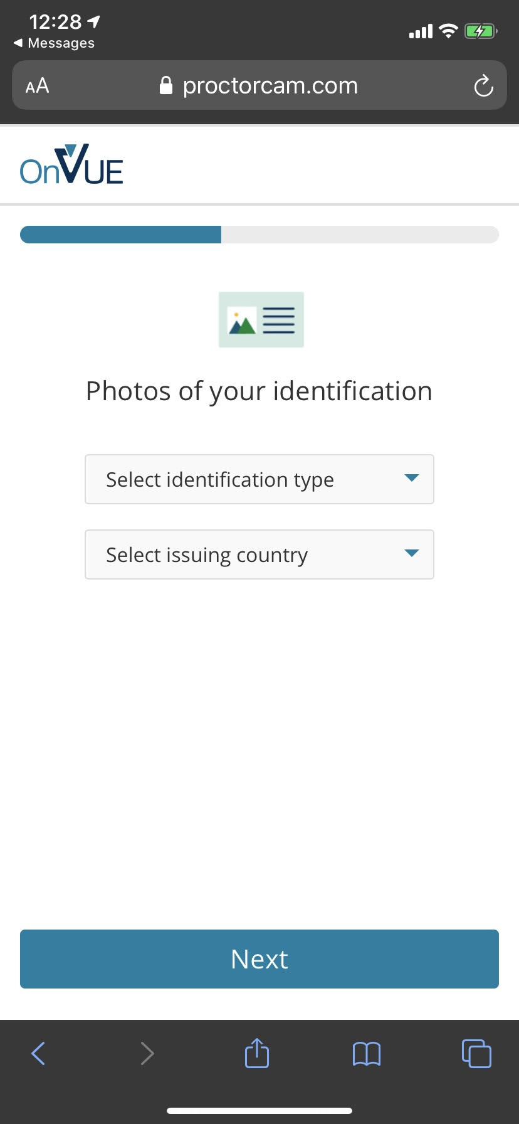
Pearson OnVUE Check-In

Slide 82
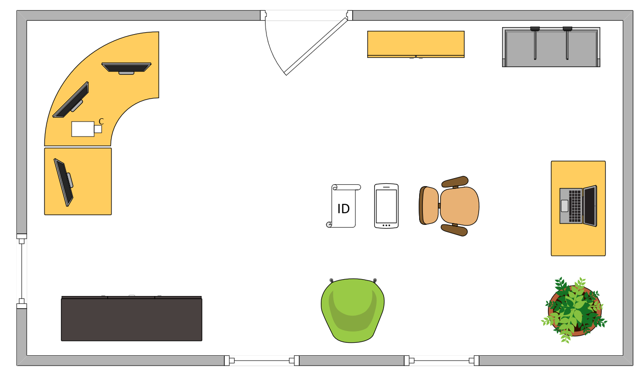
Tim’s Ideal Testing Room
No interruptions or bio breaks
Cover monitors and cameras
Pull back for environment photos
Clear table with laptop

Slide 83
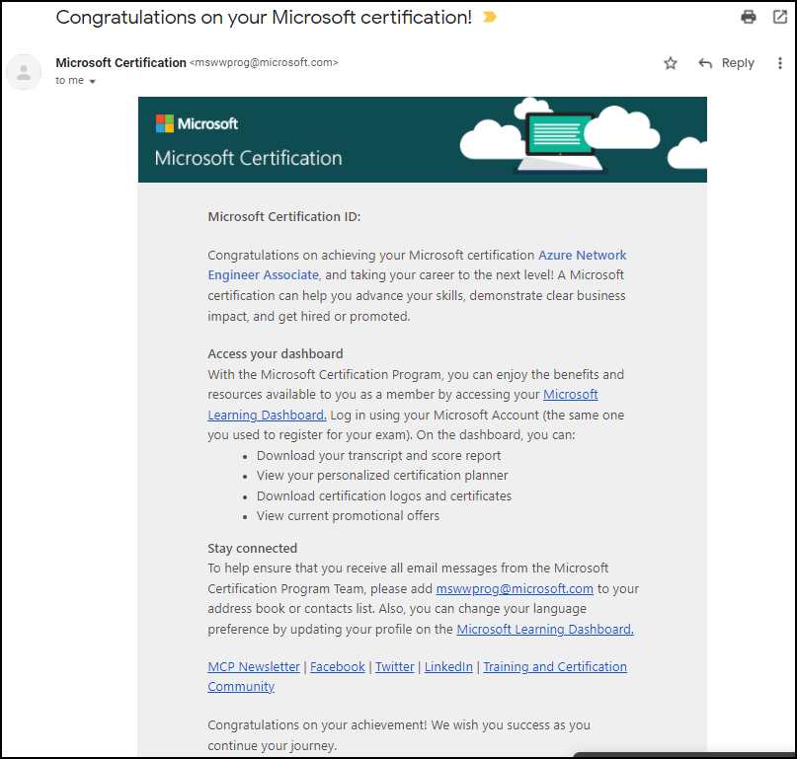
Congratulations!

Slide 84
AZ-305 Exam Strategy
Focus your skills accordingly:
60 percent Azure portal
20 percent Azure PowerShell
10 percent Azure CLI
10 percent KQL
Expect performance-based labs, but be thankful if you don't see 'em

